Slide 1
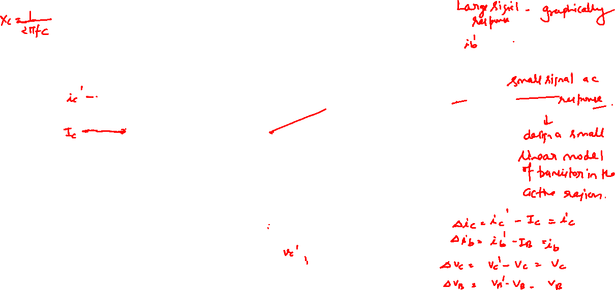
Low Frequency Response of CE Amplifier

Slide 2

Low Frequency Response of CE Amplifier
Why Coupling capacitors are opened for dc analysis and shorted for ac analysis?
Since dc voltage has a frequency of zero, the reactance of a coupling capacitor is infinite at zero frequency. Therefore, coupling capacitor is opened for dc analysis. The reactance of coupling capacitor is very low for high frequency signal. Therefore, coupling capacitor is shorted for ac analysis.
Why dc voltage source is grounded for ac analysis?
A dc voltage source has constant voltage across it. Therefore, any ac current flowing through it cannot produce an ac voltage across it. If no ac voltage can exist, the dc voltage source is equivalent to an ac short or ac ground.
Another way to understand the idea is to recall the superposition theorem.
In applying superposition theorem to a simple circuit that has a resistor, one end of which is connected to ac source and the other end is connected to a dc source.
We can calculate the effect of each acting separately while the other is reduced to zero. Reducing the dc source to zero is equivalent of shorting it. Therefore, to calculate the effect of the ac source, we can short the dc voltage source.

Slide 3


Low Frequency Response of CE Amplifier
Notation: At this point it is important to make a few remarks on transistor symbols. Specifically, instantaneous values of quantities which vary with time are represented by lowercase letters (i for current, v for voltage, and p for power).
Maximum, average (dc), and effective, or root-mean- square (rms), values are represented by the uppercase letter of the proper symbol (I, V, or P).
Average (dc) values and instantaneous total values are indicated by the uppercase subscript of the proper electrode symbol (B for base, C for collector, E for emitter).

Slide 4
Low Frequency Response of CE Amplifier
Varying components from some quiescent value are indicated by the lowercase subscript of the proper electrode symbol. A single subscript is used if the reference electrode is clearly understood. If there is any possibility of ambiguity, the conventional double-subscript notation should be used.
For example, in Figs. 8-3a to d and 8-1, we show collector and base currents and voltages in the common-emitter transistor configuration, employing the notation just described. The collector and emitter current and voltage component variations from the corresponding quiescent values are

Slide 5
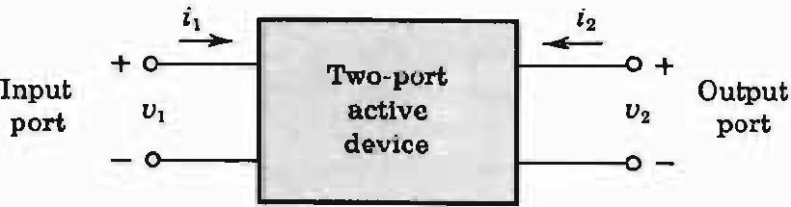


Low Frequency Response of CE Amplifier
Two-port devices and the hybrid model
Fig. 8-4
The box in Fig. 8-4 represents a two-port network. We may select two of the four quantities as the independent variables and express the remaining two in terms of the chosen independent variables.
It should be noted that, in general, we are not free to select the independent variables arbitrarily. For example, if the two-port device is an ideal transformer, we cannot pick the two voltages v₁ and v₂ as the independent variables because their ratio is a constant equal to the transformer turns ratio.

Slide 6
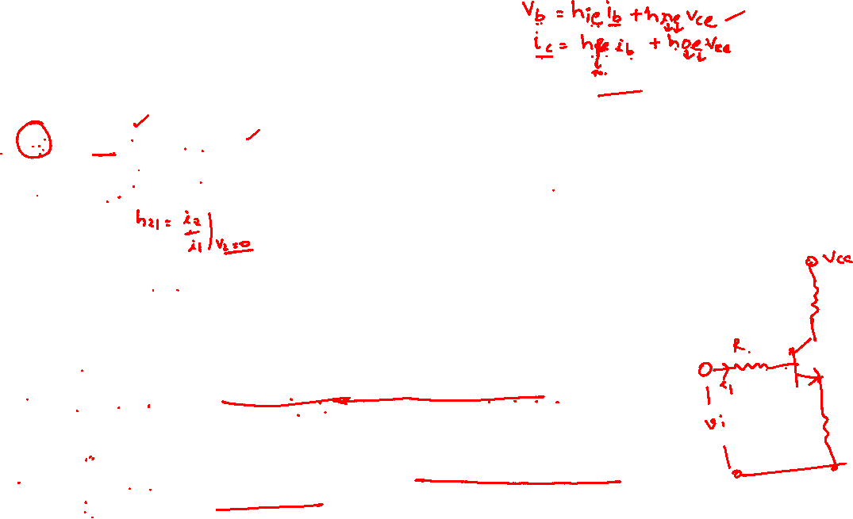

Two-port devices and the hybrid model
If the current i₁ and the voltage v₂ are independent and if the two-port is linear, we may write
Fig. 8-4
The quantities h₁₁, h₁₂, h₂₁, and h₂₂ are called the h, or hybrid, parameters because they are not all alike dimensionally. Let us assume that there are no reactive elements within the two-port network. Then, from Eqs. (8-2) and (8-3), the h parameters are defined as follows:
= input resistance with output short-circuited (ohms).
= fraction of output voltage at input with input open- circuited, or more simply, reverse-open-circuit voltage
amplification (dimensionless).

Slide 7
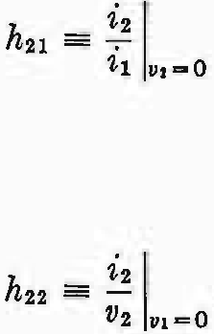

Two-port devices and the hybrid model
= negative of current transfer ratio (or current gain) with output short-circuited. (Note that the current into a load across the output port would be the negative of i2.) This parameter is usually referred to, simply, as the short-circuit current gain (dimensionless).
= output conductance with input open-circuited (mhos).
Fig. 8-4

Slide 8

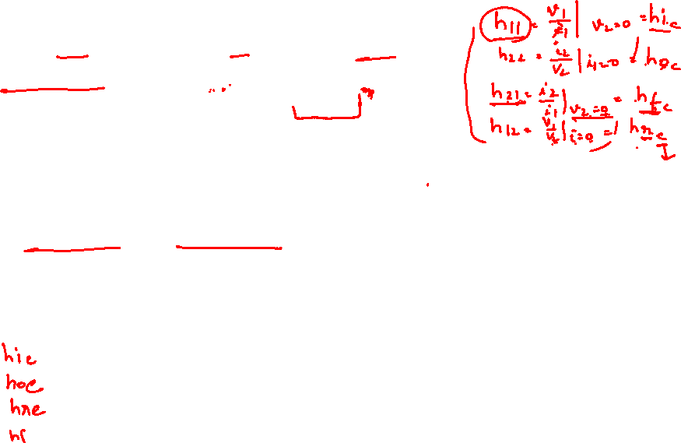

Two-port devices and the hybrid model (8/2)
Notation: The following convenient alternative subscript notation is recommended by the IEEE Standards:
i = 11 = input o = 22 = output
f = 21 = forward transfer r = 12 = reverse transfer
In the case of transistors, another subscript (b, e, or c) is added to designate the type of configuration. For example,
h_{ib} = h_{11b} = input resistance in common-base configuration
h_{fe} = h_{21e} = short-circuit forward current gain in common-emitter circuit
Define h_{i}, h_{f}, h_{r} and h_{o} of a BJT.
Fig. 8-4

Slide 9

Two-port devices and the hybrid model (8/2)
Since the device described by Eqs. (8-2) and (8-3) is assumed to include no reactive elements, the four parameters h₁₁, h₁₂, h₂₁, and h₂₂ are real numbers and the voltages and currents v₁, v₂, and i₁, i₂ are functions of time.
However, if reactive elements had been included in the device, the excitation would be considered to be sinusoidal, the h parameters would in general be functions of frequency, and the voltages and currents would be represented by phasors V₁, V₂, and I₁, I₂.
Fig. 8-4

Slide 10
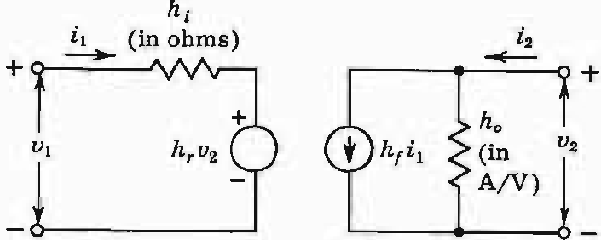

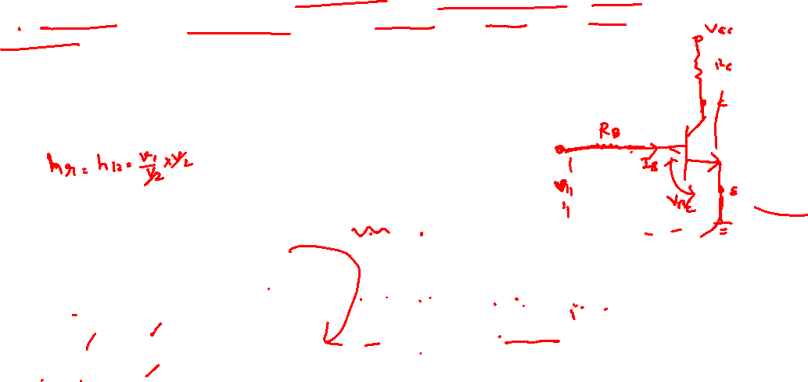
Two-port devices and the hybrid model (8/2)
The Model: We may now use the four h parameters to construct a mathematical model of the device of Fig. 8-4. The hybrid circuit for any device characterized by Eqs. (8-2) and (8-3) is indicated in Fig. 8-5.
We can verify that the model of Fig. 8-5 satisfies Eqs.(8-2) and(8-3) by writing Kirchhoff's voltage and current laws for the input and output ports, respectively.
Note that the input circuit contains a dependent voltage generator whereas the output circuit has a dependent current source.
Fig. 8-5 The hybrid model for the two-port network of Fig. 8-4. The parameters h, and hf are dimensionless.
Fig. 8-4

Slide 11
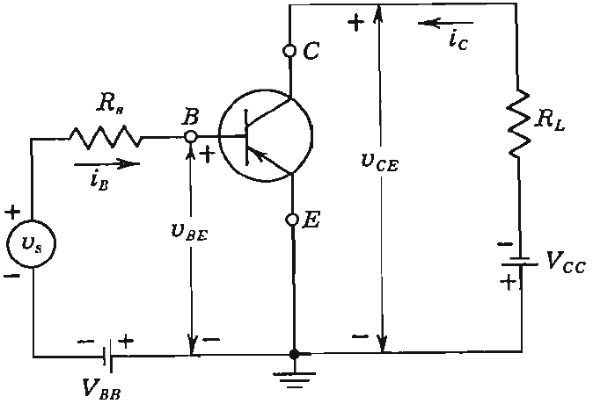
Review of hybrid models of BJT
Transistor hybrid model (8/3)
To see how we can derive a hybrid model for a transistor, let us consider the common-emitter connection shown in Fig. 8-1. The variables i_{B}, i_{C} v_{BE} = v_{B}, and v_{CE} = v_{C} represent total instantaneous currents and voltages. Since v_{B} is some function f₁ of i_{B} and v_{C} and since i_{C} is another function f₂ of i_{B} and v_{C}, we may write
Fig. 8-1 The CE transistor configuration.

Slide 12
Review of hybrid models of BJT
Transistor hybrid model (8/3)
Making a Taylor's series expansion of Eqs. (8-4) and (8-5) around the quiescent point I_{B}, V_{C}, and neglecting higher-order terms, we obtain

Slide 13



Review of hybrid models of BJT
Transistor hybrid model (8/3)
The partial derivatives are taken, keeping the collector voltage or the base current constant, as indicated by the subscript attached to the derivative. The quantities ∆v_{B}, ∆v_{C}, ∆i_{B}, and ∆i_{C} represent the small-signal (incremental) base and collector voltages and currents. According to the notation in Eq. (8-1), we represent them with the symbols v_{b}, v_{c}, i_{b}, and i_{c}. We may now write Eqs. (8-6) and (8-7) in the following form:

Slide 14

Review of hybrid models of BJT
Transistor hybrid model (8/3)
The partial derivatives of Eqs. (8-10) and (8-11) define the h parameters for the common-emitter connection. We now observe that Eqs. (8-8) and (8-9) are exactly the same form as Eqs. (8-2) and (8-3). Hence the model of Fig. 8-5 can be used to represent a transistor.
Note that the partial derivatives in Eqs. (8-10) and (8-11) are taken keeping V_{C} = constant or I_{B} = constant. If a parameter is constant, its incremental change is zero. Hence V_{C} = constant is equivalent to v_{c} = 0 and I_{B} = constant corresponds to i_{b} = 0. With this notation,
where the second equation is valid if sinusoidal (phasor) voltages and currents are under consideration.

Slide 15
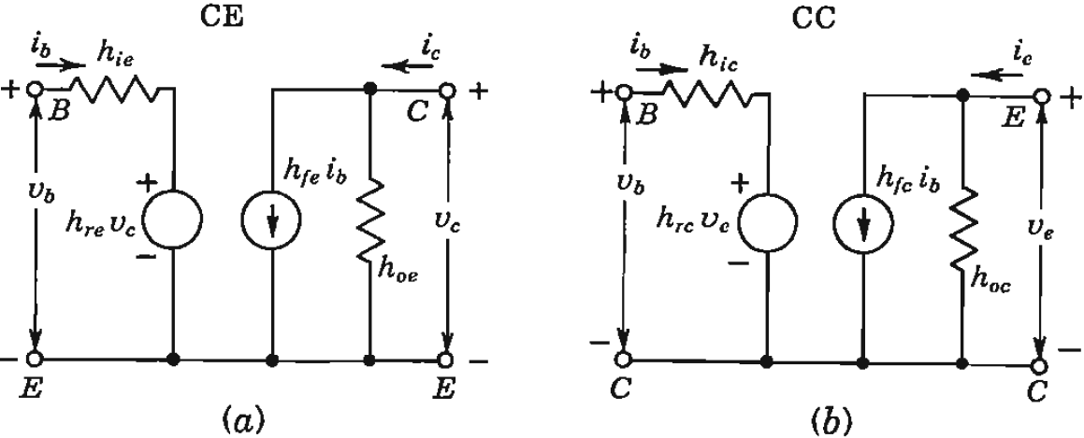

Review of hybrid models of BJT
Transistor hybrid model (8/3)
The common-emitter (CE) h-parameter model is shown in Fig. 8-6a. The common-collector (CC) hybrid model is given in Fig. 8-6b. An analogous equivalent circuit (Fig. 8-10) can be drawn for the common-base (CB) circuit, with input terminals E and B and output terminals C and B. For each configuration, we note from Kirchhoff's current law that
The circuit models and equations are valid for either an n-p-n or a p-n-p transistor and are independent of the type of load or the method of biasing.
Fig. 8-6 The hybrid small-signal models for (a) the common-emitter and (b) the common-collector configuration.

Slide 16
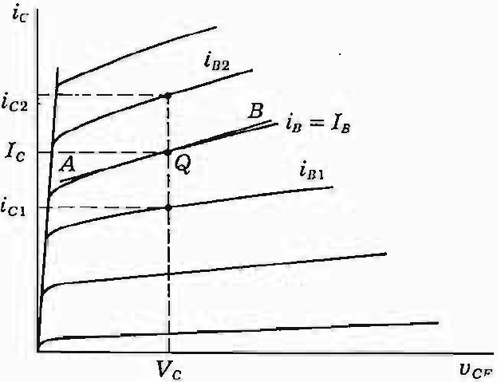


The h parameters (8/4)
The Parameter h_{fe}: For a common-emitter connection the output characteristics are shown in Fig. 8-7. From the definition of h_{fe} given in Eq. (8-11) and from Fig. 8-7, we have
The current increments are taken around the quiescent point Q, which corresponds to the base current i_{B} = I_{B} and to the collector voltage v_{CE} = V_{C} (a vertical line in Fig. 8-7).
Fig. 8-7 Determination of h_{fe} and hie from the CE output characteristics.

Slide 17

The h parameters (8/4)
The Parameter h_{oe} : From Eq. (8-11)
The value of h_{oe} at the quiescent point Q is given by the slope of the output characteristics at that point. The slope can the evaluated by drawing the line AB in the Fig. 8-7 a tangent to the characteristic curve at the point Q.
The parameters h_{ie} an h_{re} may be obtained graphically from the input CE characteristics in a manner analogous to that illustrated in Fig. 8-7.
Fig. 8-7 Determination of h_{fe} and h_{oe} from the CE output characteristics.

Slide 18
The h parameters (8/4)
Hybrid-parameter Variations:
Since the shape and actual numerical values of the characteristic curves depend on the junction temperature, the value of h parameters also depend on temperature. Therefore, the most transistor data sheets include curves of the variation of the h parameters with quiescent point and temperature as shown in Fig. 8-8a and b.
These curves are plotted with respect to the values of a specific operating point, say, −5V collector-to-emitter voltage and −1 mA collector current. The variation in h parameters as shown in Fig. 8-8a is for a constant junction temperature of 25℃ and a frequency of 1 kHz.
The value of h parameters depends on (a) junction temperature, (b) collector current, (c) base current, (d) all of them.

Slide 19
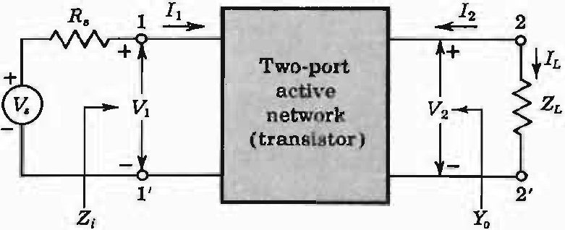
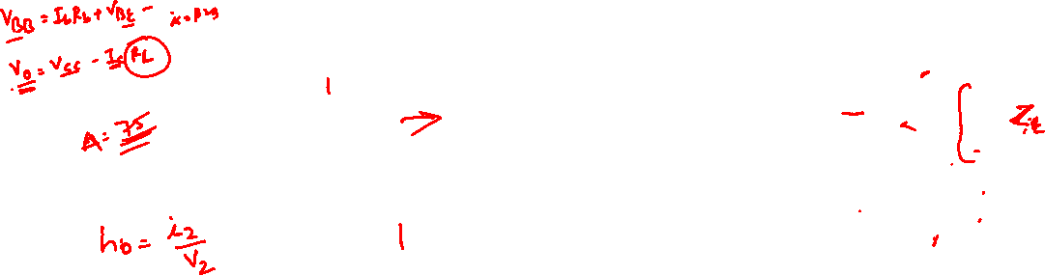
Analysis of a Transistor Amplifier Circuit using h parameters (8/6)
To form a transistor amplifier, it is only necessary to connect an external load and signal source as indicated in Fig. 8-11 and to bias the transistor properly. The two-port active network of Fig. 8-11 represents a transistor in any one of the three possible configurations.
Fig. 8-11 A basic amplifier circuit.

Slide 20
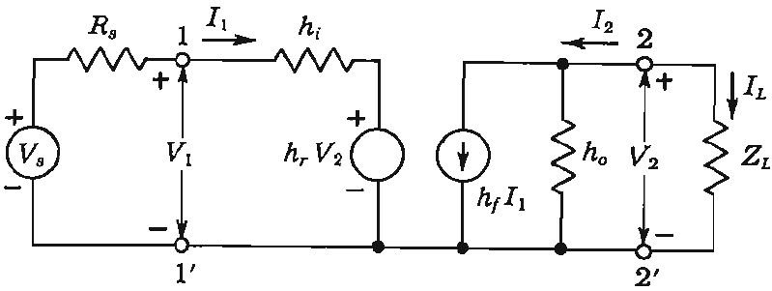
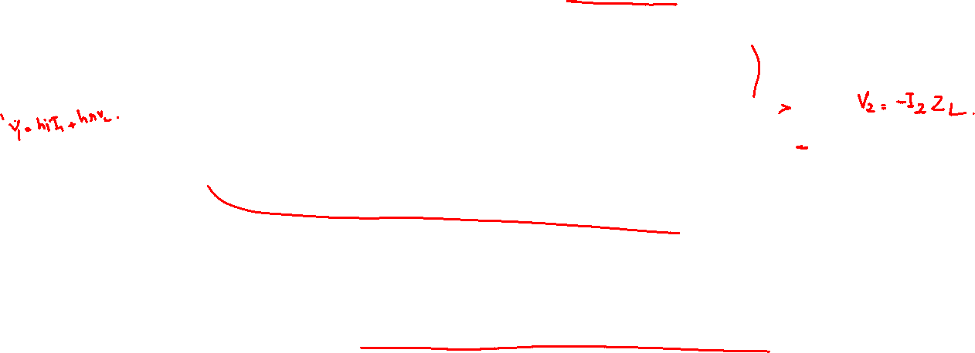
Analysis of a Transistor Amplifier Circuit using h parameters (8/6)
In Fig. 8-12 we treat the general case (connection not specified) by replacing the transistor with its small-signal hybrid model. The circuit used in Fig. 8-12 is valid for any type of load, whether it be a pure resistance, an impedance, or another transistor.
Fig. 8-12 The transistor in Fig. 8-11 is replaced by its h-parameter model.
Draw small-signal hybrid model of a BJT independent of specific configuration indicating its voltage, current, impedance/resistance and h parameters.

Slide 21

Analysis of a Transistor Amplifier Circuit using h parameters (8/6)
Now we proceed to analyze the circuit in Fig. 8-12. The quantities of interest are the current gain, the input impedance, the voltage gain and the output impedance.
The Current Gain, or Current Amplification, A_{I} is defined as the ratio of output to input currents, or
From the circuit in Fig. 8-12, we have
Derive the expression of current gain from the small-signal hybrid model of a BJT independent of specific configuration.
Fig. 8-12

Slide 22
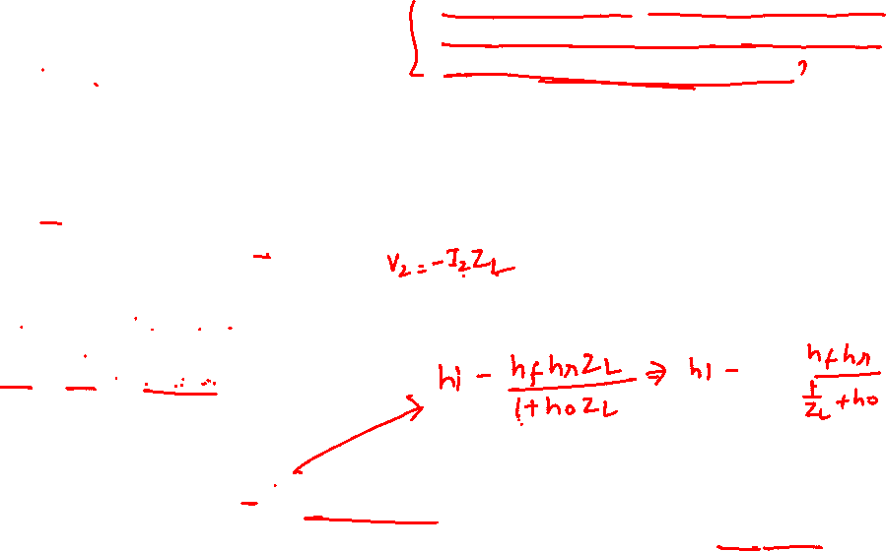
Analysis of a Transistor Amplifier Circuit using h parameters (8/6)
The input impedance Z_{i}:
Derive the expression of input impedance from the small-signal hybrid model of a BJT independent of specific configuration.
From the input circuit of Fig. 8-12, we have
Since
Substituting in Eq. (8-21), we obtain
Here Eq. (8-18) has been used and as we know that the load admittance is Y_{L} = 1/Z_{L}. Note that the input impedance is the function of load impedance.

Slide 23

Analysis of a Transistor Amplifier Circuit using h parameters (8/6)
The Voltage Gain, or Voltage Amplification, A_{V} : The ratio of output voltage V₂ to input voltage V₁ gives the voltage gain of the transistor, or
Derive the expression of voltage gain from the small-signal hybrid model of a BJT independent of specific configuration.
From Eq. (8-22), we have
Fig. 8-12

Slide 24
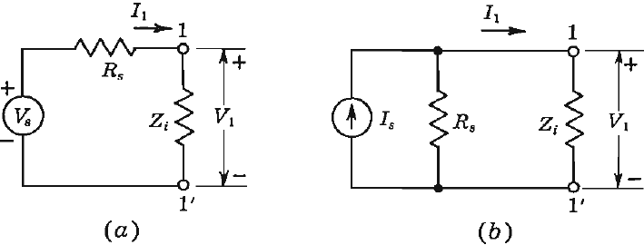
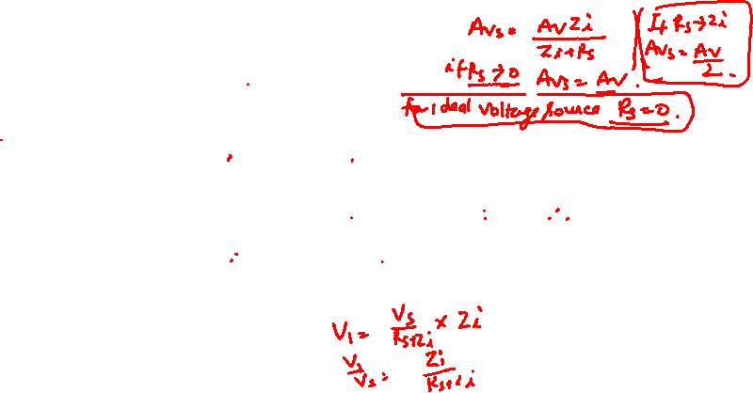

Analysis of a Transistor Amplifier Circuit using h parameters (8/6)
The Voltage Amplification, A_{Vs} taking into account the Resistance R_{s} of the Source: This overall voltage gain A_{Vs} is defined by
Derive the expression of voltage gain taking source resistance into consideration from the small-signal hybrid model of a BJT independent of specific configuration.
From the equivalent circuit of the amplifier, shown in Fig. 8-13a,
Then
Where use has been made of Eq. (8-25)
Fig. 8-13 Input circuit of a transistor amplifier using (a) a Thevenin's equivalent for the source and (b) a Norton's equivalent for the source.

Slide 25

Analysis of a Transistor Amplifier Circuit using h parameters (8/6)
Note that, if R_{s} = 0, then A_{Vs} = A_{V} . Hence A_{V} is the voltage gain for an ideal voltage source (one with zero internal resistance). In practice, the quantity A_{Vs} is more meaningful than A_{V} since, usually, the source resistance has an appreciable effect on the overall voltage amplification. For example, if Z_{i} is resistive and equal in magnitude to R_{s} then A_{Vs} = 0.5A_{V}.
Fig. 8-13 Input circuit of a transistor amplifier using (a) a Thevenin's equivalent for the source and (b) a Norton's equivalent for the source.

Slide 26
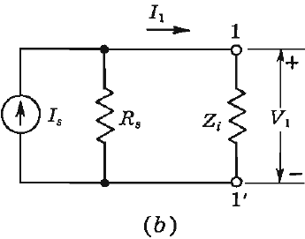
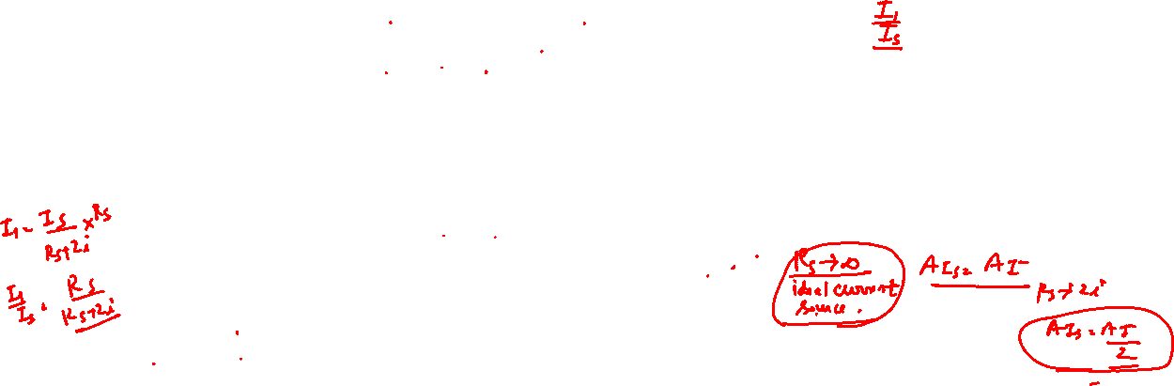
Analysis of a Transistor Amplifier Circuit using h parameters (8/6)
The Current Amplification, A_{Is} taking into account the Resistance R_{s} of the Source:
If the input source is a current generator I, in parallel with a resistance R_{S}, as indicated in Fig.8-13b, the overall current gain A_{IS} is defined by
Derive the expression of current gain taking source resistance into consideration from the small-signal hybrid model of a BJT independent of specific configuration.
From Fig. 8-13b
And hence
Fig.8-13b
Fig. 8-12

Slide 27
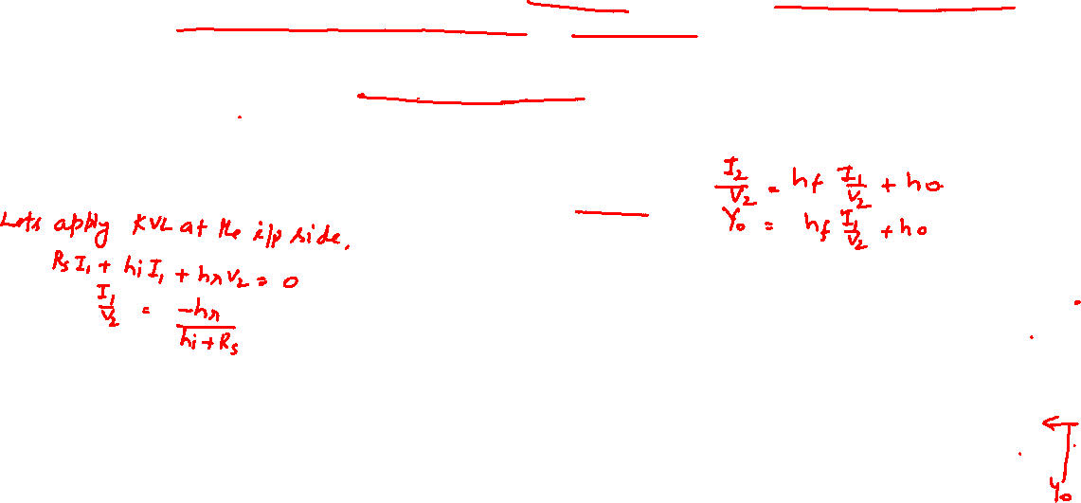
Analysis of a Transistor Amplifier Circuit using h parameters (8/6)
The Output Admittance: By definition, the output impedance Z_{O} = 1/Y_{O} is obtained by setting the source voltage V_{S} to zero and the load impedance Z_{L} to infinity and by driving the output terminals from a generator V₂. If the current drawn from V₂ is I₂, then
From Eq. (8-17)
Derive the expression of output admittance taking source resistance into consideration from the small-signal hybrid model of a BJT independent of specific configuration.
Fig. 8-12

Slide 28

Analysis of a Transistor Amplifier Circuit using h parameters (8/6)
The Output Admittance:
From Fig. (8-12) with V_{S} = 0
Substituting the expression for I₁/V₂ from Eq.(8-34) in Eq. (8-32), we obtain
Derive the expression of output admittance taking source resistance into consideration from the small-signal hybrid model of a BJT independent of specific configuration.
Fig. 8-12

Slide 29
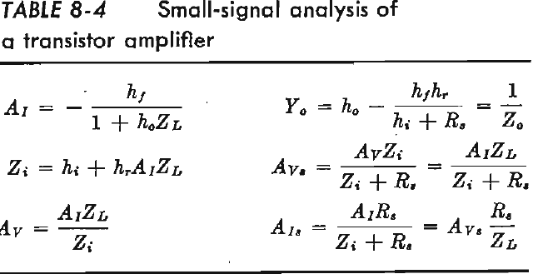

Analysis of a Transistor Amplifier Circuit using h parameters (8/6)
Note that the output admittance is a function of the source resistance. If the source impedance is resistive, as we have assumed, then Y_{O} is real (a conductance)
In the above definition of Y_{O} = 1/Z_{O}, we have considered the load Z_{L} external to the amplifier. If the output impedance of the amplifier stage with Z_{L} included is desired, this loaded impedance can be calculated as the parallel combination of Z_{L} and Z_{O}.
Summary: The important formulas derived above are summarized for ready reference in Table 8-4. Note that the expressions for A_{V}, A_{VS}, and A_{IS} are obtained without reference to the hybrid parameters, and hence are valid regardless of what equivalent circuit we use for the transistor (for example, these expressions are valid for high-frequency hybrid-II model of Sec. 11-5).
Draw the hybrid model for a CB transistor and write the input and output equations.
Draw the hybrid model for a CE transistor and write the input and output equations.
Draw the hybrid model for a CC transistor and write the input and output equations.

Slide 30
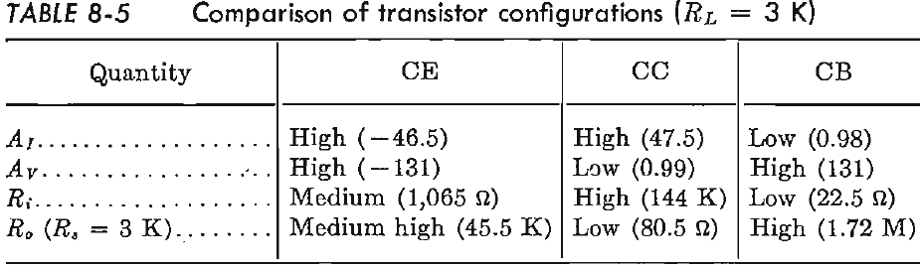

Comparison of Transistor Amplifier Configurations (8/9)
CE Configuration: From the curves and Table 8-5, it is observed that only the common-emitter stage is capable of both a voltage gain and a current gain greater than unity. This configuration is the most versatile and useful of the three connections.
Name the transistor configuration that is capable of both a voltage gain and a current gain greater than unity. (a) CE, (b) CB, (c) CC, (d) none of them.
Which transistor configuration is the most versatile and useful? (a) CE, (b) CB, (c) CC, (d) all of them.
Compare its voltage gain (A_{v}), input resistance (R_{i}) and output resistance (R_{o}) with those of common-emitter (CE) configuration.
Compare its voltage gain (A_{v}), input resistance (R_{i}) and output resistance (R_{o}) with those of common-base (CB) configuration.

Slide 31
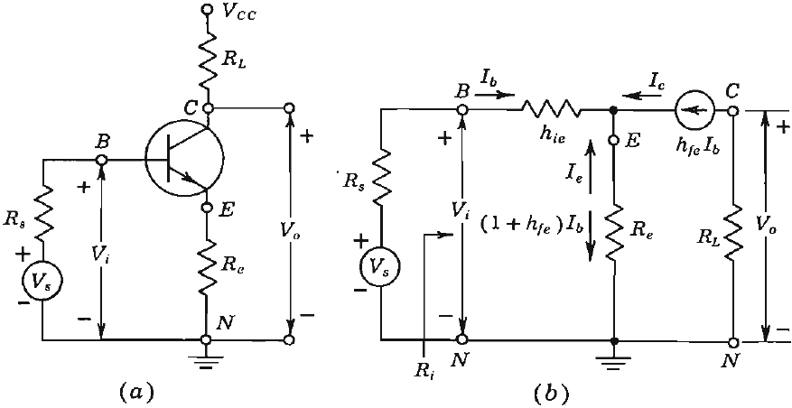
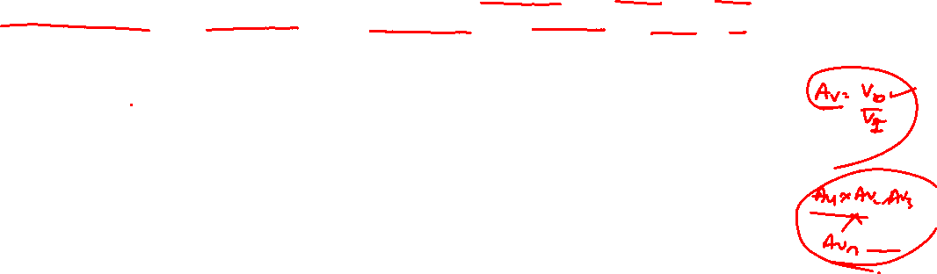
The Common-Emitter Amplifier with an Emitter Resistance (8/15)
Very often a transistor amplifier consists of a number of CE stages in cascade. Since the voltage gain of the amplifier is equal to the product of the voltage gains of each stage, it becomes important to stabilize the voltage amplification of each stage.
A simple and effective way to obtain voltage-gain stabilization is to add an emitter resistor R_{e} to a CE stage, as indicated in the circuit of Fig. 8-26. This stabilization is a result of the feedback provided by the emitter resistor.
Draw a transistor-level circuit diagram of CE amplifier with an emitter resistor.
Fig. 8-26(a) Common-emitter amplifier with an emitter resistor. (b) Approximate small-signal equivalent circuit.

Slide 32
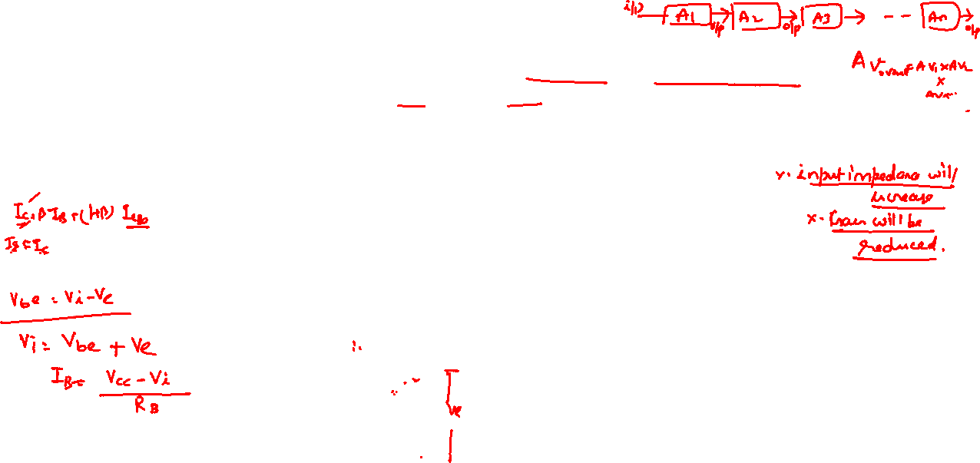
The Common-Emitter Amplifier with an Emitter Resistance (8/15)
We show in this section that the presence of R_{e} has the following effects on the amplifier performance, in addition to the beneficial effect on bias stability. It leaves the current gain A_{I} essentially unchanged; it increases the input impedance by (1+h_{fe})R_{e} ; it increases the output impedance; and under the condition (1 + h_{fe})R_{e} >> h_{ie}, it stabilizes the voltage gain, which becomes essentially equal to −R_{L}/R_{e} (and thus is independent of the transistor).
Fig. 8-26(a) Common-emitter amplifier with an emitter resistor. (b) Approximate small-signal equivalent circuit.
Draw the small-signal equivalent circuit of a CE amplifier with an emitter resistor.

Slide 33
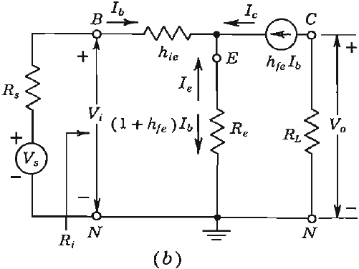
The Common-Emitter Amplifier with an Emitter Resistance (8/15)
The Approximate Solution: An approximate analysis of the circuit of Fig. 8-26a can be made using the simplified model of Fig. 8-26a as shown in Fig. 8-26b.
The current gain is, from Fig. 8-26b,
The input resistance, as obtained from inspection of Fig. 8-26b, is
The input resistance is augmented by (1+ h_{fe})R_{e}, and may be very much larger than h_{ie}. For example, if R_{e}= 1 kΩ and h_{fe} = 50, then (1+ h_{fe})R_{e} = 51 kΩ >> h_{ie} ≈ 1 kΩ.
Fig. 8-26(b)

Slide 34

The Common-Emitter Amplifier with an Emitter Resistance (8/15)
The Approximate Solution: Hence, an emitter resistance greatly increases the input resistance. The voltage gain is (using Eq. (8-58) and (8-59))
Clearly, the addition of an emitter resistance greatly reduces the voltage amplification. This reduction in gain is often a reasonable price to pay for the improvement in stability.
We note that, if (1+h_{fe})R_{e} >> h_{ie}, and since h_{fe} >> 1, then
Subject to the above approximations, A_{V} is completely stable (if stable resistances are used for R_{L} and R_{e}), since it is independent of all transistor parameters.
Explain the advantage and disadvantage of using emitter resistance in CE amplifier.
Fig. 8-26(b)

Slide 35
The Common-Emitter Amplifier with an Emitter Resistance (8/15)
The Approximate Solution:
The output resistance of the transistor alone (with R_{L} considered external) is infinite for the approximate circuit of Fig. 8-26, just as it was for the CE amplifier of Sec. 8-13 with R_{e} = 0. Hence the output impedance of the stage, including the load, is R_{L}.
Why output resistance is infinite?

Slide 36
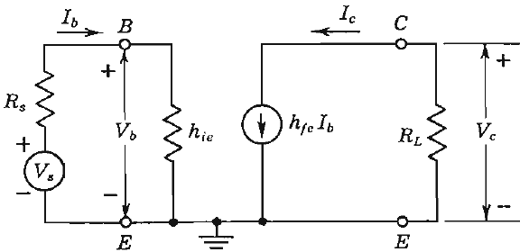

The Common-Emitter Amplifier with an Emitter Resistance (8/15)
The Approximate Solution:
Output Impedance: The simplified circuit of Fig. 8-24 has infinite output resistance because, with V_{S} = 0 and an external voltage source applied at the output, we find I_{b} = 0, and hence I_{C} = 0 (Note that when a current source h_{fe}I_{b} is zero it is assumed to be open circuited). However, the true value depends upon the source resistance R_{S} and lies between 40 kΩ and 80 kΩ (Fig. 8-16d).
Provide approximate solutions (expressions) of voltage gain, current gain, input resistance and output resistance of CE amplifier with emitter resistance.
Fig. 8-24 Approximate CE model.

Slide 37
The Common-Emitter Amplifier with an Emitter Resistance (8/15)
The Exact Solution: complete derivation and analysis can be found in the book)

